Slide 2

Ecclesiastes 1:9
“That which has been is what will be, That which is done is what will be done, And there is nothing new under the sun.”
Our youth is going to the dogs!

Slide 3


Potential Wasted if They Are Not Directed In The Right Way!

Slide 4
The Power Of Our Influence
Notes:
ID=d924773e-9a16-4d6d-9803-8cb819e99682
Recipe=text_billboard
Type=TextOnly
Variant=0
FamilyID=AccentBoxWalbaum_Zero

Slide 5
“Individual Accountability”
Romans 14:12 “So then each of us shall give account of himself to God.”
“It’s nobody’s business what I do!”
Romans 14:13 “Therefore let us not judge one another anymore, but rather resolve this, not to put a stumbling block or a cause to fall in our brother's way.”
Matthew 18:6 “But whoever causes one of these little ones who believe in Me to sin, it would be better for him if a millstone were hung around his neck, and he were drowned in the depth of the sea.“
We can STIR, SWAY and PERSUADE others by OUR INFLUENCE!

Slide 6
We Can Do As Much HARM If Our Influence is BAD!
1 Timothy 4:12 “be an example to the believers in word, in conduct, in love, in spirit, in faith, in purity."
We Are Influencing SOMEONE!
And This Influence Is Either For GOOD or for EVIL!
Example in WORD – SOUND WORDS – Titus 2:7,8
Matthew 12:37 “For by your words you will be justified, and by your words you will be condemned."

Slide 7
Timothy was to be an example in:
1 Timothy 4:12 “be an example to the believers in word, in conduct, in love, in spirit, in faith, in purity."
Conduct– “It is the behavior that proceed from our hearts and NOT the book in our hands that will impress people.”
James 3:13 “show by good conduct {that} his works {are done} in the meekness of wisdom."
2 Peter 3:11 “holy conduct and godliness,"

Slide 8

What Kind Of An Influence Do We Have?
Is It For GOOD, Or For BAD?

Slide 9
Timothy was to be an example in:
1 Timothy 4:12 “be an example to the believers in word, in conduct, in love, in spirit, in faith, in purity."
Obedience – Ephesians 6:1,2 “obey your parents”

Slide 10
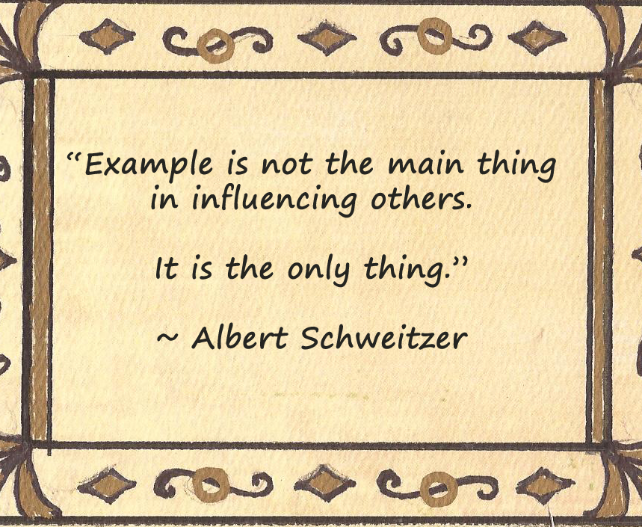

Slide 11
Timothy was to be an example in:
1 Timothy 4:12 “be an example to the believers in word, in conduct, in love, in spirit, in faith, in purity."
Obedience – Ephesians 6:1,2 “obey your parents”
Hebrews 5:8,9 “ He learned obedience by the things which He suffered”
If we would TEACH our children OBEDIENCE….
LET’S LIVE IT!

Slide 12
Timothy was to be an example in:
1 Timothy 4:12 “be an example to the believers in word, in conduct, in love, in spirit, in faith, in purity."
Purity Of Life – “It’s one thing to TALK about a pure life, and quite another thing to LIVE IT!”
1 Peter 1:22 “purified your souls in obeying the truth”
Be A Faithful Christian
High Moral Standards Revealed in God’s Word!
LIVE THEM!
John 12:48; Matthew 5:8

Slide 13
Evil Examples Must Be Avoided
Swearing or Cursing – Exodus 20:7 “not take the name of the Lord your God in vain”
James 3:8-10 “Out of the same mouth proceed blessing and cursing. My brethren, these things ought not to be so."
Euphemisms – substitutes for God, Jesus and vile words that no business coming from the mouth of a Christian

Slide 14
Evil Examples Must Be Avoided
Immodest Apparel – 1 Timothy 2:9,10 “modest apparel, with propriety and moderation, not with braided hair or gold or pearls or costly clothing, (10) but, which is proper for women professing godliness, with good works."
Drinking Alcohol – Proverbs 23:20,31,32
Proverbs 20:1 “Wine is a mocker, intoxicating drink arouses brawling, and whoever is led astray by it is not wise.”

Slide 15
Evil Examples Must Be Avoided
Dancing– Galatians 5:19 NKJV 19 Now the works of the flesh are evident, which are: adultery, fornication, uncleanness, lewdness,”
Lewdness, Lasciviousness or Licentiousness - "wanton acts or manners, as filthy words, indecent bodily movements, unchaste handling of males and females."
Parents Are To Be EXAMPLES – Judges 7:17 “"...Look at me and do likewise; watch, and when I come to the edge of the camp you shall do {just} as I do."

Slide 16

Set The Proper Example!
If you are not a Christian, become one today!
If you are an unfaithful child of God, repent and be faithful to the Lord!
If you are already a faithful child of God, continue to set the proper example for your children and all those around you!

